Slide 1
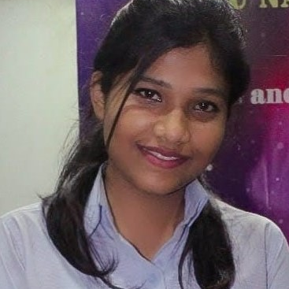



Manjima Bhusan
Analyst/Software Engineer
Bachelor of Engineering
Computer Science : 2018 - 2022
Skills
Mumbai
Java 8 /J2EE | Java Basics, OOPS, Collections, Arrays, Loops, Lambda Exp, Stream API Junit, Mockito
Spring core | IOC & Dependency Injection, Autowire
Spring REST | REST controllers, Implementation of GET, POST, PUT & DELETE & Exception Handling, Testing Services, Controller & Repository layer
Spring Data JPA | Implement DAO layer using spring Data repositories
Spring Boot Microservices | Spring Boot Starters, annotations, Messaging Service, Swagger API documents
Spring Cloud | Eureka, Netflix Hystrix & Config Server
React | Components, Hooks, Event handling
Database | MongoDB No Sql Basics, PostgreSQL.
UI Tech | HTML 5 & CSS 3,Bootstrap, ES6 & JavaScript
Tools | Git, Postman, Maven,Eclipse IDE
Devops | CI/CD, Jenkins configuration, Build Pipelines, notifications, quality gate understanding
Add On skills | Communications, Team management. Peer learning
xxxxxxxxxxx@capgemini.com
+91 7003122845
A4
Full Stack Developer
Hands on experience in creating microservices with Spring boot, Spring Security, JWT Security Authentication, Role Based Authorization, Spring Cloud API Gateway, Eureka server and postman .
Hands on experience in developing web pages using HTML5, CSS3, ES6, JSON. Good understanding of Document Object Model (DOM) .
Hands on experience in implementing case study with ReactJs & spring boot.
Experience in creating documentation and testing RESTful APIs with swagger and in unit testing using Junit, Mockito.
Have knowledge in MongoDB Atlas and PostgreSQL.
Have understanding in implementation of RabbitMQ.
Online Railway Reservation System
Completed end to end case study of Online Railway Reservation System along with JWT authentication, Swagger and made a responsive UI with HTML, CSS and some ES6 concepts and ReactJs used for user interface.
Online Shopping Application
Completed end to end case study of Online Shopping Application along with Monolithic architecture, database using PostgreSQL using Spring boot and used ReactJS for user interface.
Check out my work on GitHub & Video Profile

